Slide 1


PATTERN RECOGNITION IN STOCK MARKET
CAPSTONE PROJECT PRESENTATION
Great Lakes Institute of Management, Bangalore

Slide 2
TEAM MEMBERS
AMBER GUPTA
PIYUSH JAIN
POONAM SHARMA
VIBHOR PRASAD
JAGDISH D
COURSE & BATCH
PGPBA 2016 - 2017
MENTOR
Mr. Rajesh Jakhotia

Slide 3
OBJECTIVE
USE MODERN STATISTICS AND MACHINE LEARNING TECHNIQUES TO IDENTIFY PRICE PATTERNS IN COMMON EQUITIES.

Slide 4
STOCK MARKET ANALYSIS
Fundamental Analysis | Technical Analysis
Based on Sales, Earning Cash Flow, Management Quality and other financial parameter based | Price, Volume, Sentiment based
Data gets generated once in 3 month | Data generated daily
Requires understanding of product , services , sector expertise | Requires understanding of charts, technical indicators , patterns
Scope of analytics is limited and already saturated | Lots of scope of analytics i.e. pattern recognition, sentiment analysis
Multiplier effect if both can be combined using Analytics

Slide 5

Using Patterns Based Tech Analysis
Pattern Building
Similar Price Patterns
Sum total of fundamental data + news + sentiments all other factors results into various patterns that keep forming across markets
Patterns are not exactly same anytime but similar.
Dependent Data Points
Different Time Scales
Daily Price are not independent data points. They are dependent on previous price points.
Formation of similar price patterns can be seen on various time scales.
Historical Profitable Patterns
Series of Price Points
Historically profitable patterns have shown to occur consistently across markets (stocks, forex, commodities or anywhere there is speculative intent).
Single day price do not convey any information, intelligence comes with series of price’s point behavior.

Slide 6
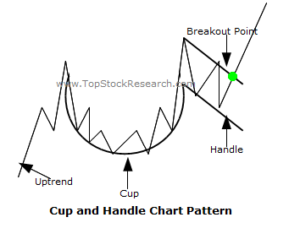
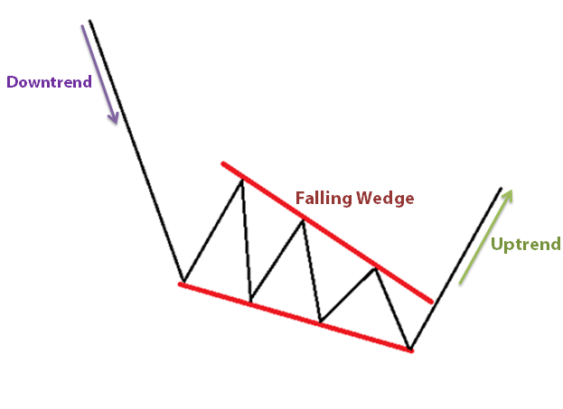
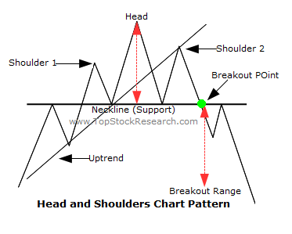
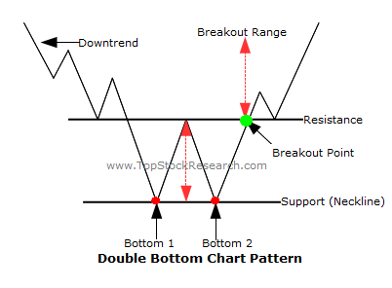
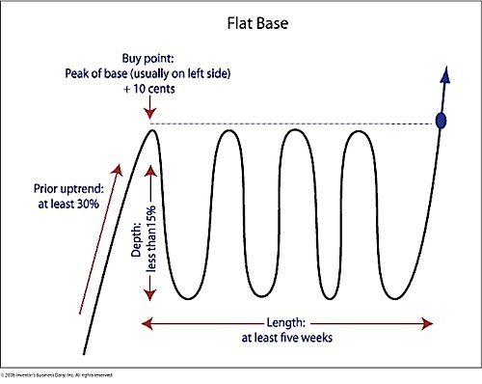
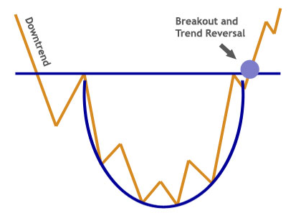
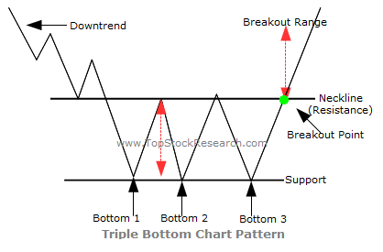
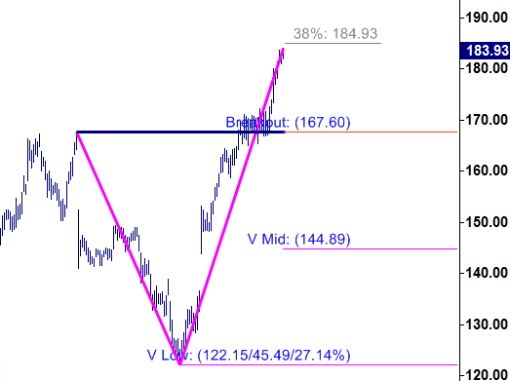
CLASSIC CHART PATTERNS
Double Bottom
Head and Shoulder
Falling/Rising Wedge
Rounding Bottom
Triple Bottom Reversal
Cup and Handle Price Channel
Flat Base/Consolidation
V or single bottom reversal

Slide 7
WHICH PATTERNS AND WHY?
Out of many patterns we selected double bottom, short V and flat base.
Manual identification of patterns from 500 stocks is time consuming hence aim is to automate the process.
Initiated with 3 patterns to affirm that this case can be done using data analytics.

Slide 8
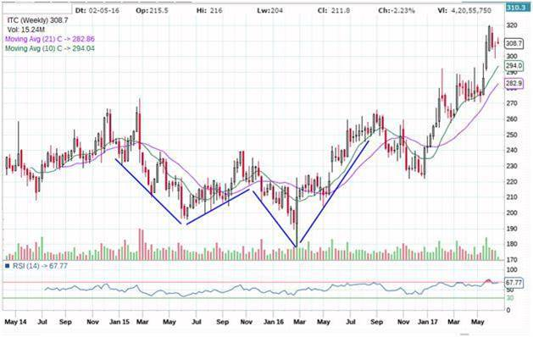
DOUBLE BOTTOM PATTERN

Slide 9
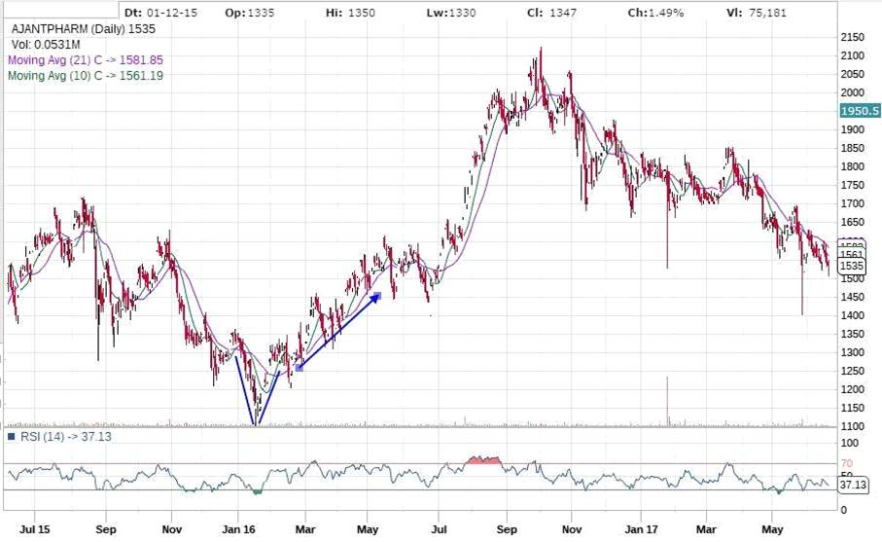
V/SINGLE BOTTOM REVERSAL

Slide 10
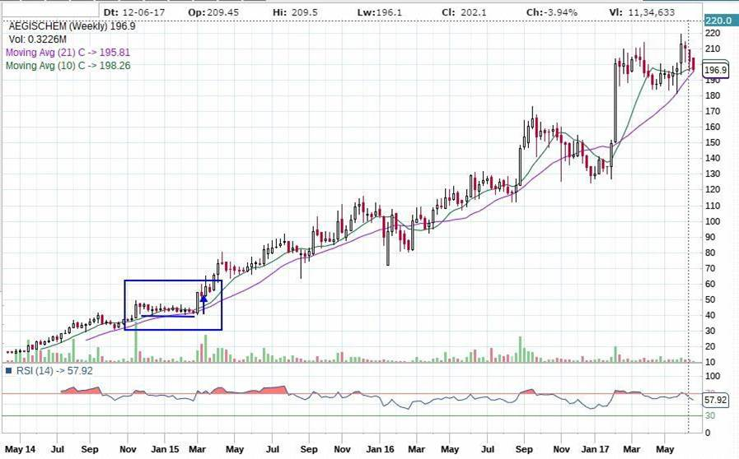
FLAT BASE OR CONSOLIDATION

Slide 11
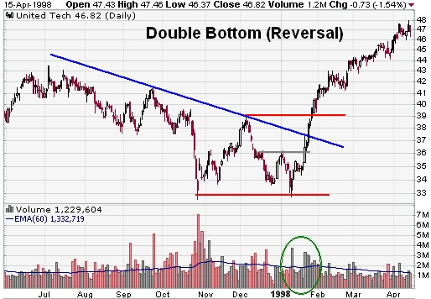
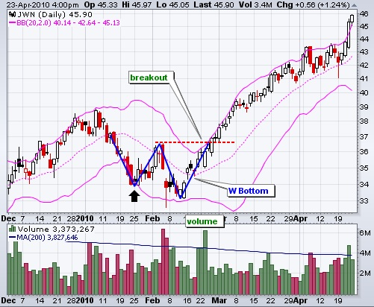
Double Bottom at different Scales

Slide 12
DATA PREPARATION
Data Sources – NSE, Money Control, Synthetic Data.
Data Collection – Manual pattern identification, Synthetic Data Generation.
Data Cleaning
Data Labelling
Consolidation: consol-valid (1); Double Bottom: db-valid (1); V Pattern: V Pattern (1); Invalid data – Invalid(1)
Data Preparation
0 - No pattern; 1 - Consolidation pattern; 2- V pattern; 3- Double bottom pattern
Data Upload – Exported data as csv files and uploaded it to the mysql server.

Slide 13
TOOLS AND TECHNIQUES
Multinomial classification using NNet packages
Pattern Matching - R, Python
Website : PHP, Java Script, JQuery, HTML, CSS
Database : MySQL

Slide 14
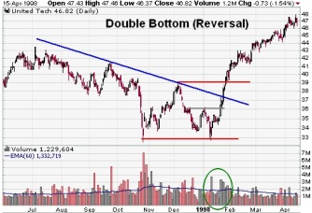

Guidelines For Feature Generation
Consider a sample Double Bottom (W) Pattern
Feature Testing for Uniqueness for valid and invalid patterns
6
1
5 Distinct Points in W Pattern are converted to numerical feature of distinct values
5
2
Magnitude of the Stock Price and its Time Scale vary
4
3
Avoided Time Series as we are matching only shape
Scaling is done on the price and time axis

Slide 15
“Feature Dataset” Generation Flow
Dataset for model building includes standard valid data, synthetic data and actual invalid datasets.
Verified valid patterns of W, V and Consolidation patterns are used as reference.
Feature Generation Algorithm
File | V | W | HC1.VC | HC1.Slope | Class
V-Valid-4.csv | 2.2349798 | 1.2198561 | 5.49 | 4.7 | 2
Cons-valid-1.csv | 2.3440655 | 1.3927185 | 2.05 | 1.587 | 1
Db-valid11.csv | 6.5975363 | 0.7095062 | 4.14 | 21.692 | 3
Synthetic-db-valid11.csv | 5.8172651 | 0.6885395 | 4.84 | 16.089 | 3
AIAENG_2017-03-31_40.csv | 5.7264167 | 1.5815606 | 3.76 | 84.664 | 0

Slide 16
Output for Feature Dataset
File Name | V Feature | W Feature | C Feature1 | C Feature2 | Class
C Pattern1 | 7.8048059 | 1.9463891 | 2.44 | 13.273 | 1
C Pattern 2 | 8.1539289 | 2.0268 | 2.37 | 16.07 | 1
C Pattern 3 | 7.9797245 | 1.9788546 | 2.05 | 18.981 | 1
V Pattern 1 | 2.4501626 | 1.6067647 | 2.75 | -43.377 | 2
V Pattern 2 | 0.6378845 | 1.3076504 | 27.34 | -7.96 | 2
DB Valid 1 | 4.2720836 | 0.1829844 | 2.42 | 15.724 | 3
DB Valid 2 | 4.9787029 | 0.5539281 | 5.22 | 20.991 | 3
DB Valid 3 | 1.4583048 | 0.8169096 | 2.37 | 4.178 | 3
Non Pattern1 | 6.0601701 | 0.4399789 | 6.95 | -1.876 | 3
Non Pattern 2 | 830 2.1234 | 337 4.17 | 34 | 985 0 | 0
Non Pattern 3 | 4.564451 | 1.8573717 | 11.19 | -51.665 | 0

Slide 17
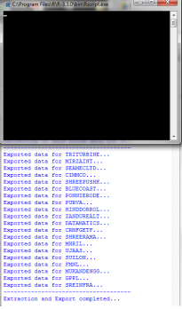
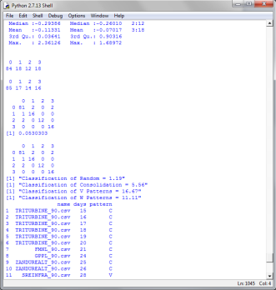
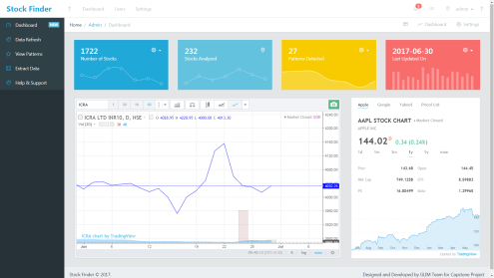
Model Building Flow
Standard Valid Datasets
Synthetic Datasets
Invalid Datasets
Random Datasets
Datasets
1
Multinomial Classification
Neural Network
Logistic Regression
2
Model
Final Output
3

Slide 18
Feature Detection In Real Data
Classification
Model
Feature
Generation
03
Live data for
Specified
range.
02
STEP 4
01
STEP 3
STEP 2
STEP 1

Slide 19
PERFORMANCE METRICS
Confusion Metrics | Actual
Predicted Class | No Pattern | Consolidation | Short V | Double Bottom
No Pattern | 77 | 3 | 0 | 1
Consolidation | 9 | 29 | 0 | 0
Short V | 1 | 0 | 18 | 0
Double Bottom | 3 | 0 | 0 | 27
Overall Model Accuracy | 89.88%
Overall TPR | 89.02
Overall FPR | 4.49%

Slide 20

LIVE DEMO
REALTIME STOCK STATS
LIVE DATA EXTRACTION
DATA EXPORT
RANDOM DATA SAMPLING
PATTERN RECOGNITION USING PYTHON & R
RESULT SHOWCASE
ANALYTICS

Slide 21
SCOPE OF IMPROVEMENT
Models
Incorporating and testing more models like Neural Network, SVM etc.
Accuracy
Improving accuracy of the model by improving algorithm and dataset.
New Patterns
Quick and Flexible deployment scenarios so that new patterns could be added with slight code changes.
Algorithms
Developing algorithms for other profitable patterns.
Integration
Seamless Integration of the Stock Data and
Real-time Analytics

Slide 22

THANK YOU FOR YOUR TIME

